Slide 1
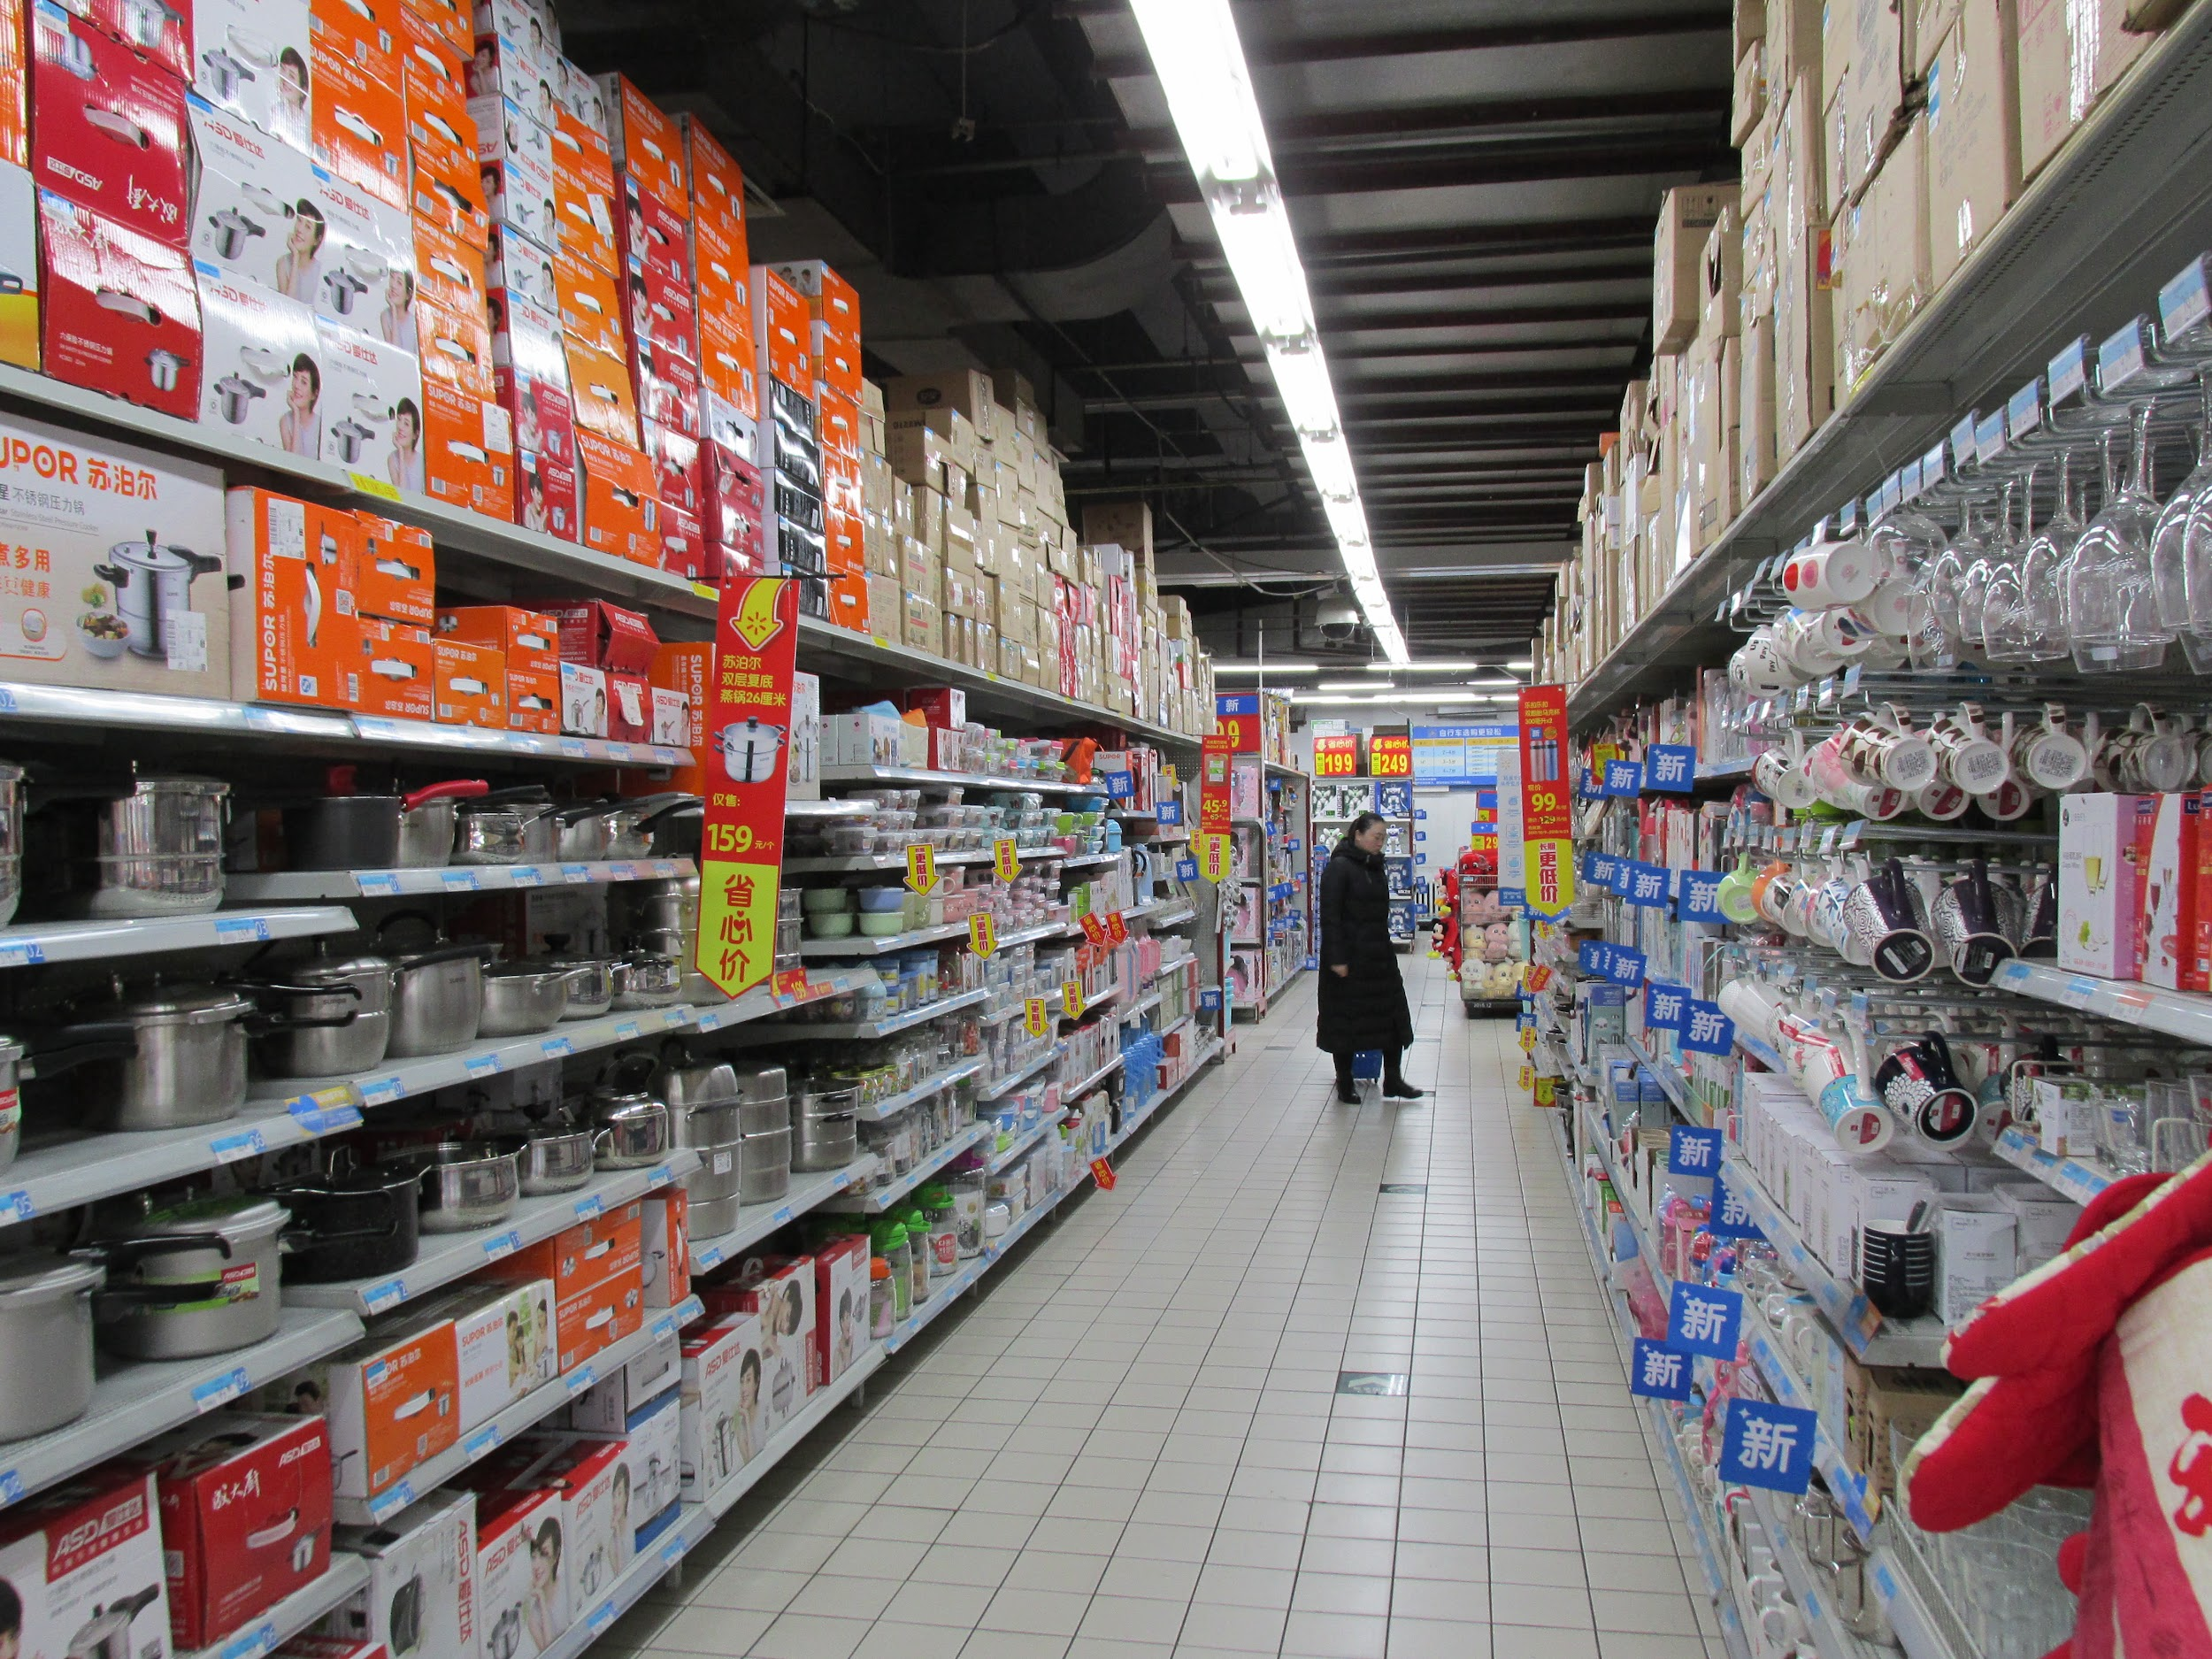
Grocery Store Sales
A data science oriented review of data collected based on grocery sales

Slide 2
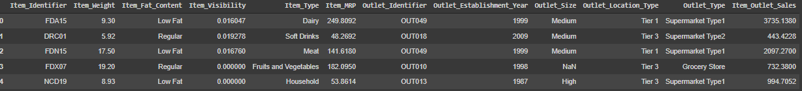
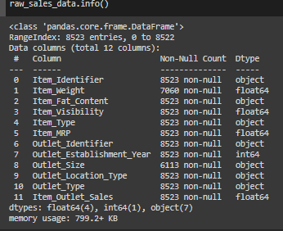

Data Overview

Slide 3
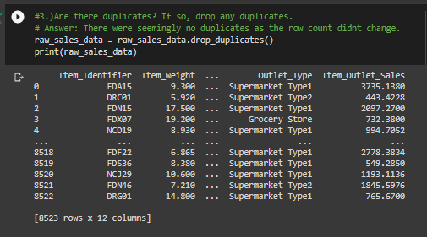
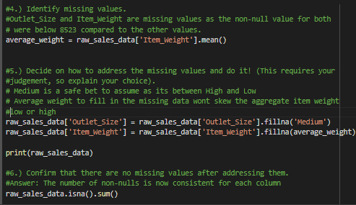
Data Cleanup

Slide 4
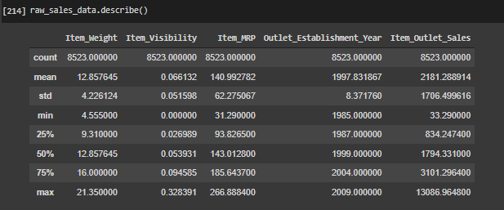
Data Distribution

Slide 5
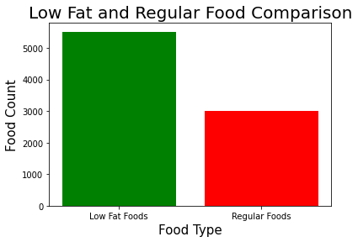
Visualizing Data via Histogram

Slide 6
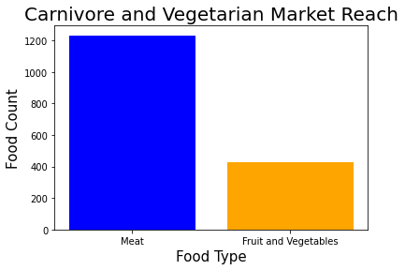
Visualizing Data via Histogram
Part 2

Slide 7
Prediction Models
Decision Tree Accuracy: 0.8071328015016425
Bagged Tree Accuracy: 0.3901563196946719
Random Forest Regressor Accuracy: 0.4617846947106713
Based off of the performance of the three models, the Decision Tree had the most accurate result, which would be my most recommended model.

